Slide 1
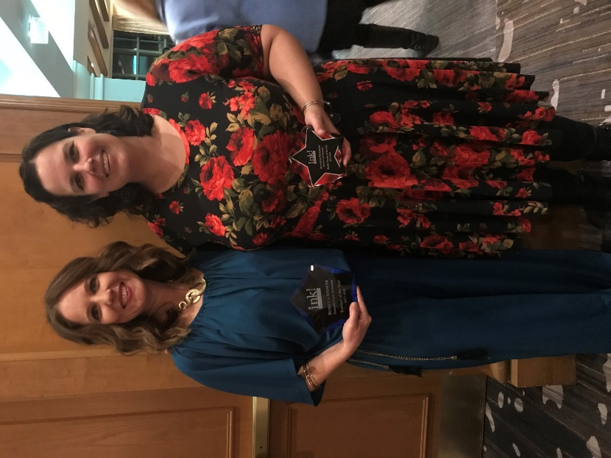
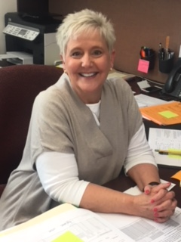
Eagle SOAR-ce Newsletter
http://www-tce.stjohns.k12.fl.us/
February 6, 2018
(904) 547-7400
TCE’s Teacher & Rookie Teacher of the Year!
Important February Dates
Friday, Feb. 9th: Interim reports issued
Saturday, Feb. 10th: Father-Daughter Dance
PreK, KDG, 1st & 2nd Grades 4-6pm
3rd, 4th, & 5th Grades 7-9pm
Friday, Feb. 16th: Jump Rope for Heart Fundraisers Due
Monday, Feb. 19th: President’s Day/No School
Friday, Feb. 23rd: Spirit Sticks Sale
Wednesday, Feb. 28th: Pennies for Patients Fundraiser Due
Please join the faculty and staff in congratulating Mrs. Rebecca Spencer as TCE’s Teacher of the Year and Mrs. Jennifer Piniarski as TCE’s Rookie Teacher of the Year. Mrs. Spencer is currently in her third year at Timberlin Creek. Prior to coming to TCE, Mrs. Spencer taught for twelve years in Indiana and West Virginia. Mrs. Piniarski started her teaching career last year at TCE. Teaching is a second career for Mrs. Piniarski as she spent 20 years serving as a social worker. Mrs. Spencer and Mrs. Piniarski were recently honored at a banquet along with the teachers from across the St. Johns County School District. We are thankful for the work Mrs. Spencer and Mrs. Piniarski do for our students each day.
Welcome Mrs. Rene Jones
Mrs. Jones comes to us with eight years of experience in the St. John’s County School District. Prior to joining the TCE team, she served as the LEA clerk at Liberty Pines Academy. Some of her hobbies/interests include cooking and reading. Mrs. Jones loves to spend time at Farmers’ Markets with her 145 pound Great Dane, Duke.
Please join us in welcoming the newest member of our extraordinary Eagle team, Mrs. Rene Jones. Mrs. Jones is our new secretary/ bookkeeper.
February’s Character Counts Pillar: Caring
Wear red on Wednesdays in February to show compassion and kindness.

Slide 2
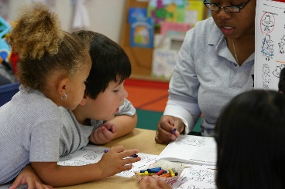
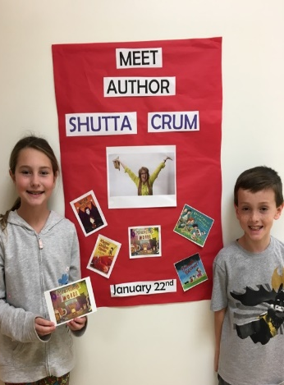
Eagle SOAR-ce Newsletter (pg. 2)
http://www-tce.stjohns.k12.fl.us/
February 6, 2018
(904) 547-7400
TCE’s Literacy Week: Find Yourself in a Book!
MLK Poster Contest
entered essays and
posters to celebrate this American hero.
Congratulations to these TCE student winners from Mrs. Rapoza’s KDG class:
Semi-Finalists:
Savannah Orr &
Carter Hudson
Finalist:
Mckinzy Moore
3rd Place:
Jayden Forbrich
The St. Johns Education Association partnered with the Dr. Martin Luther King Celebration Committee of St. Johns County to celebrate the life and works of MLK. Students from around the district
Literacy Week took place the week of January 22nd . This year’s theme was Find Yourself in a Book. Timberlin was proud to host author Shutta Crum during our Monday night kickoff. Students enjoyed meeting Mrs. Crum, listening to her stories and getting advice on writing. Families visited a book swap, students took pictures in photo booths, created character puzzles and even had the opportunity to build a project based on a book. Throughout the week students also shared poetry, unusual books and even dressed as their favorite book character.
Thank you for sharing literacy week with us at Timberlin and please continue to have your child read four or more days outside of school each week.
January Character Counts
Congratulations to the following students who represented their class for the character pillar of RESPECT.
PreK: Burhanuddin J., Joshua C.
Kindergarten: Ethan A., Emmie S., Valentina G., Walker B., Gwyneth A., Alyssa F., Isla B.
First Grade: Lily Kate J., Emily W., Aubrey C., Maddox W., Kadence L., Juliette H., Ezra C., Aylah G.
Second Grade: Caroline B., Amanda A., Anya E., Vishruth M., Maya G., Addison L., Lara B., Pearson P.,
Third Grade: Sierra W., Hamsini N., Jaxon R., Daniel D., Taylor D., Tyler R., Reed H., Paige S., Michael T.
Fourth Grade: Claire F., Emma C., Sydney S., Meah G., Ariz L., Abigail W., Austen A.
Fifth Grade: Katie T., Reese R., Gabriella A., Camryn P., Lauralyn D., Layla T., Will B., Heidi E.
Kindergarten Registration Dates for 2018-19 School Year
Tuesday, March 13 and Tuesday, March 20 from 9:00 a.m. to 1:00 p.m.
Wednesday, April 4 and Wednesday, April 11 from 1:00 p.m. to 5:00 p.m.

