Slide 1
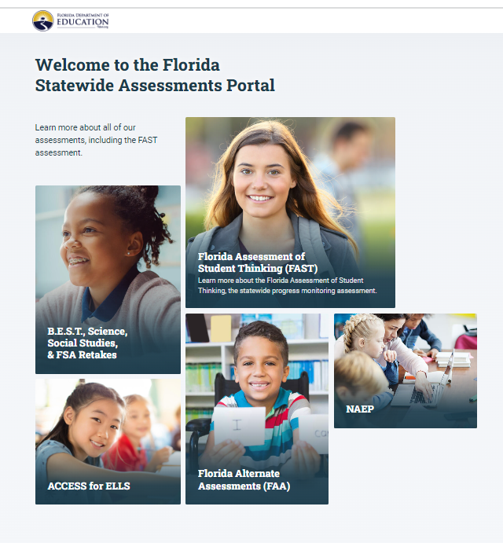
Parent Learning Series: Session 1
Topics Covered in tonight’s session:
-FAST Testing Information for Families
-Statewide Testing Resources
-School Data Overview

Slide 2
FAST Florida Assessment of Student Thinking
Florida Assessment of Student Thinking, or FAST, refers to the new Coordinated Screening and Progress Monitoring (CSPM) System assessments, which are aligned to the Benchmarks in Excellent Student Thinking (B.E.S.T.) Standards.
FAST assessments include VPK through grade 10 English Language Arts (ELA) and VPK through grade 8 Mathematics.
ELA and Mathematics Test Design Summary and Blueprints are posted on FDOE webpage.
https://www.fldoe.org/accountability/assessments/k-12-student-assessment/best/
End-of-Course (EOC) assessments are not part of FAST.

Slide 3
Administration Schedule
Per s. 1008.25(8), F.S., FAST assessments will be administered three times per year, the first (PM1) will occur at the start of the school year (for VPK and K-2 only within the first 30 days), the second (PM2) will occur in the middle of the school year, and the third (PM3) will occur at the end of the school year.
Test content for all three administrations is secure, test items cannot be copied, distributed, or used for classroom instruction.
The dates for the three windows during the 2023–24 school year are as follows:
• PM1: August 10- September 21 (VPK & K-2) August 15–September 29, 2022 (3-10)
• PM2: December 4, 2023–January 26, 2024
• PM3: May 1–May 31, 2024

Slide 4
Testing Overview
Grades K-2; FAST (STAR Assessments)
K/1; 27 questions for ELA- 10-20 minutes
Grade 2; 34 questions for ELA- 15-20 minutes
Math K-2; 34 items 20-30 minutes
1 subject per day
Students complete subject test in 1 day
Computer-based
Grades 3-8; FAST ELA & Math
35-40 questions for both ELA & Math
Approximately 50 minutes for PM1 & PM2, but students can take up to 90 minutes
1 subject per day
Students complete subject test in 1 day
Computer-based
Results will be available through family portal

Slide 5
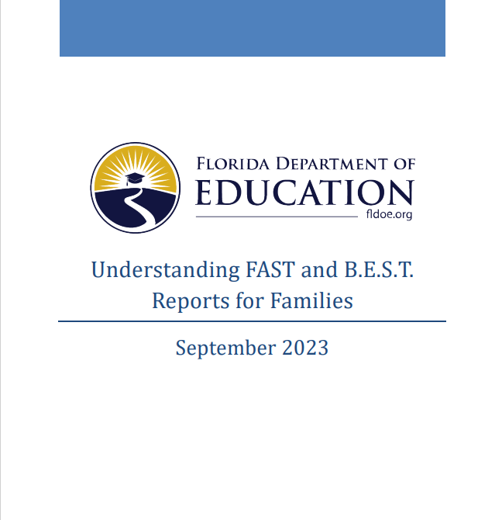
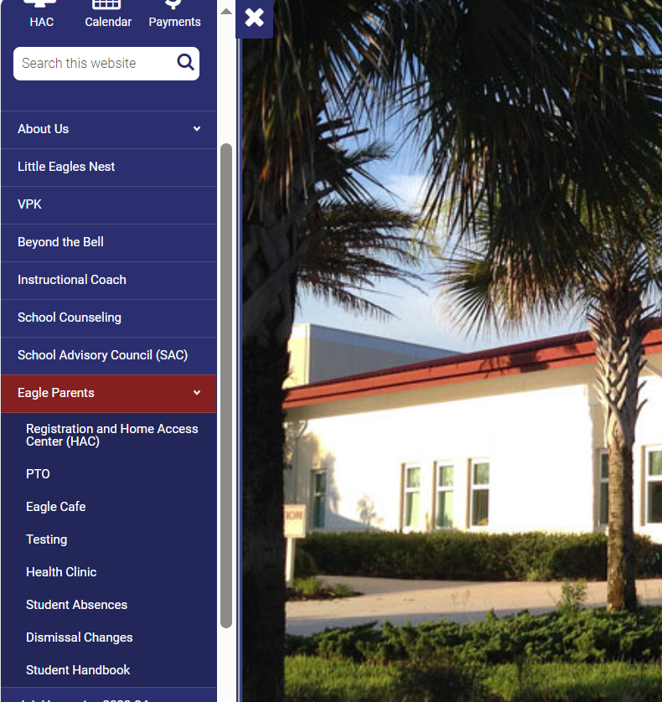
Reporting Resources for Families
Understanding Reports for Families – NEW September 2023
FAST Fact Sheets for Families
All of these resources can be found on our school website, or through the State Testing site: flfast.org
On our school website, click on Eagle Families, then click on testing

Slide 6
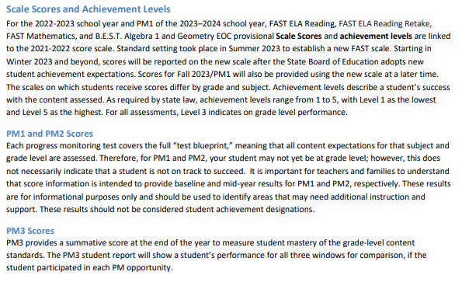
Summary:
PM1 and PM2 cover all grade level standards for the year- including topics not yet taught. Scoring a level 1 or 2 on PM1 or PM2 does not necessarily mean your child is not on track to succeed.
Test Design & Scoring

Slide 7
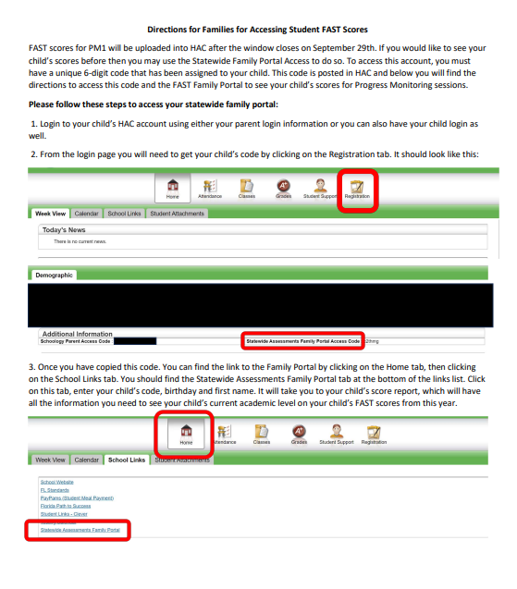
Accessing Your Student’s Scores
Parents can access student scores 2 ways:
Through HAC (approximately 2 weeks after the window closes)
Through the Statewide Family Portal (Directions for accessing the portal can be found on our school website)
Parent Portal Overview
Through the portal, families have access to student performance data
You can change the school year to view different academic years

Slide 8
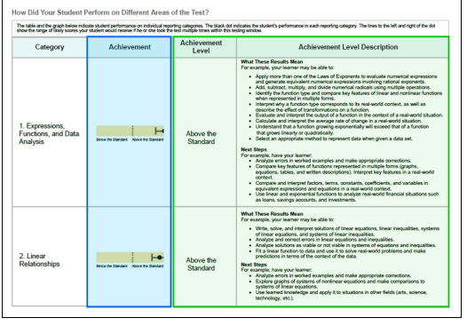
New Reporting Features 23-24

Slide 9
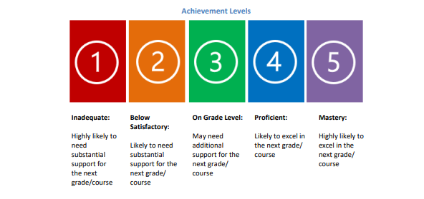
Achievement Levels
Achievement Level Descriptors: Tell how likely a student is to succeed in the NEXT grade level based on their level of mastery of the current grade level.
Remember, for PM1 and PM2, they are measuring all grade level standards (many of which have not been taught yet)
Example: a 4th grade student scoring a level 1 on PM1: Highly likely to need substantial support for the next grade/course (meaning 5th grade)
*Students who scored a Level 1 or a Level 2 on PM3 in May 2023, admin and teachers have been meeting to review and check-in to see how the student is doing this year. In some cases, we have reached out to families to discuss additional supports.

Slide 10
Grade 3
Grade 3 Reading Overview
These scores compare TCES to the state and to the district for PM1
Grade 3 Math Overview

Slide 11
Grade 4
4th Grade Reading Overview
These scores compare TCES to the state and to the district for PM1
4th Grade Math Overview

Slide 12
Grade 5
Grade 5 Reading Overview
These scores compare TCES to the state and to the district for PM1
Grade 5 Math Overview

Slide 13
Sample Items are available through flfast.org

Slide 14
Thank you for coming in tonight!
Next steps:
Check out the parent reporting options and manuals
Take a practice test online with your student
If you still have questions about testing- please let us know!

